Slide 1


IT204F
IT application
Kristen 231123H
Janice 231096R
Shavonne 231271W
Tristin 231301C

Slide 2
Table of contents
Business needs
01
03
02
04
Tristin
Shavonne
Inclusivity in business operations
Streamlining Checkout Process
Kristen
Janice
Personalized Nutrition and Dietary Accommodation
Use of digital menu

Slide 3

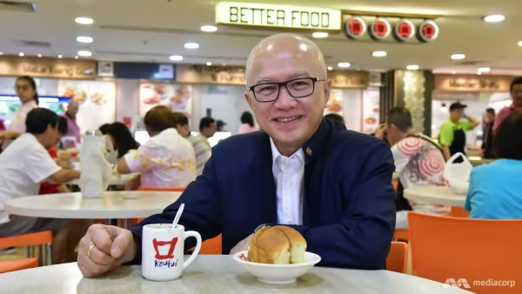
Company

Slide 4

An application that helps you order drinks online for in real life pick up
Cashless
More organised business operations
Raw data will be collected for
business decisions

Slide 5

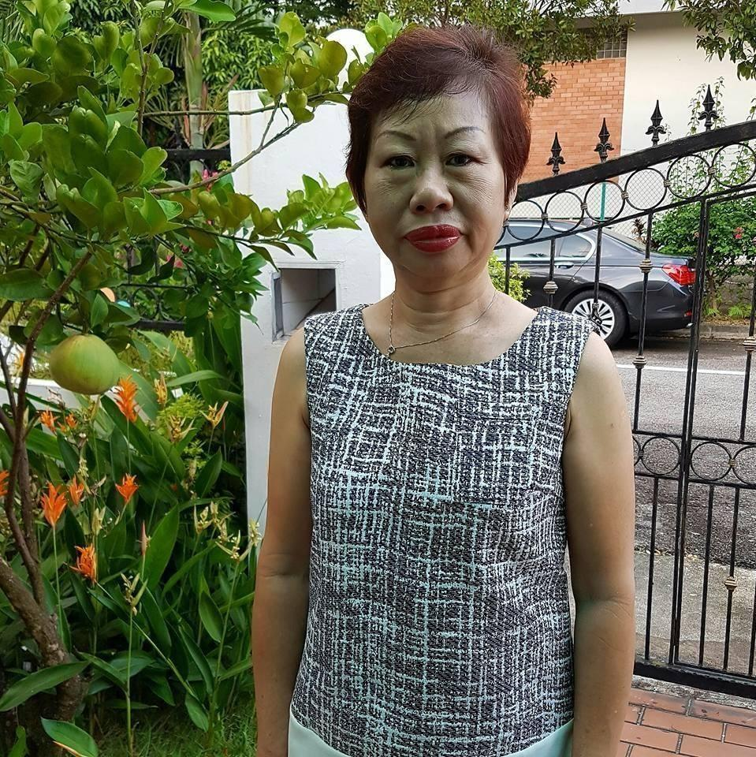


01
Aid their biggest dining customer group
Inclusivity in business operations
WHO?
The Elderly >

Slide 6
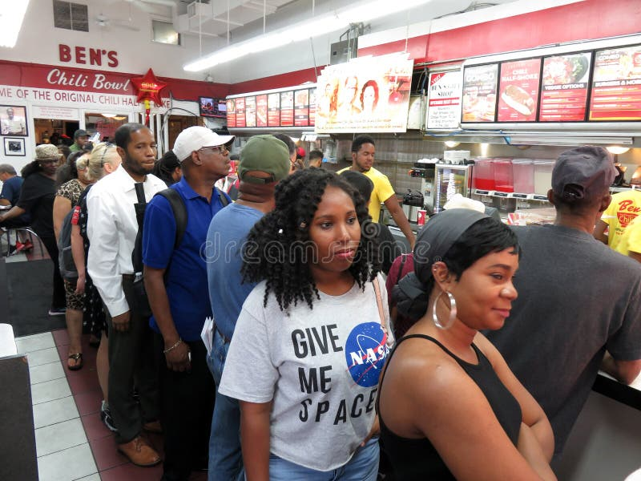

WHY?
Long lines normally occur at Koufu drink stall lines.
This may decrease sales, as customers are deterred
from purchasing due to the long lines.

Slide 7


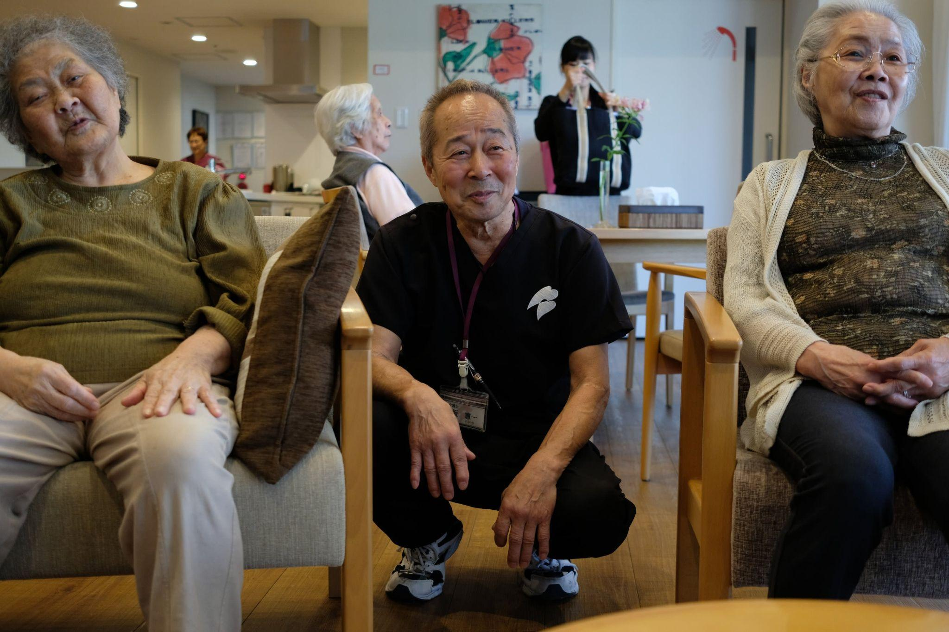
The elderly’s mobility issues

Slide 8
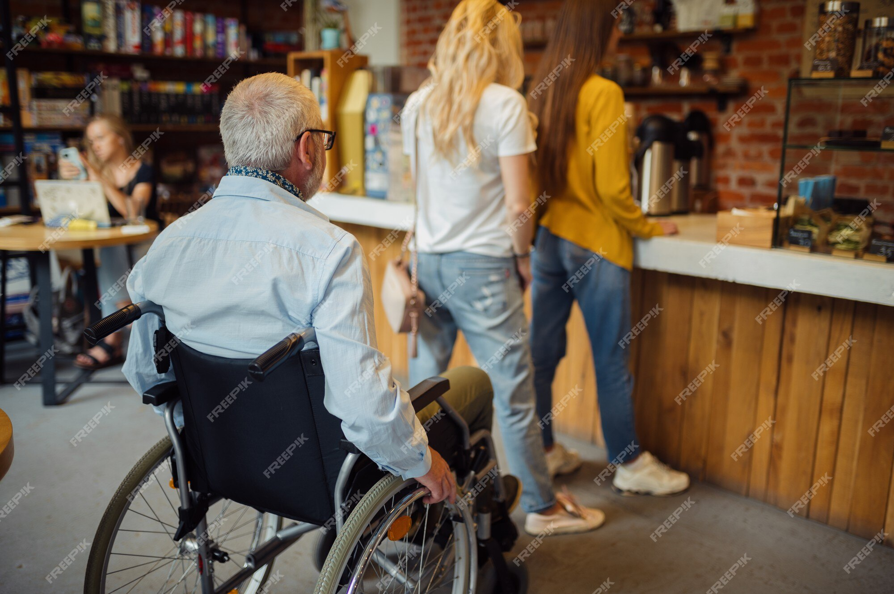

Slide 9
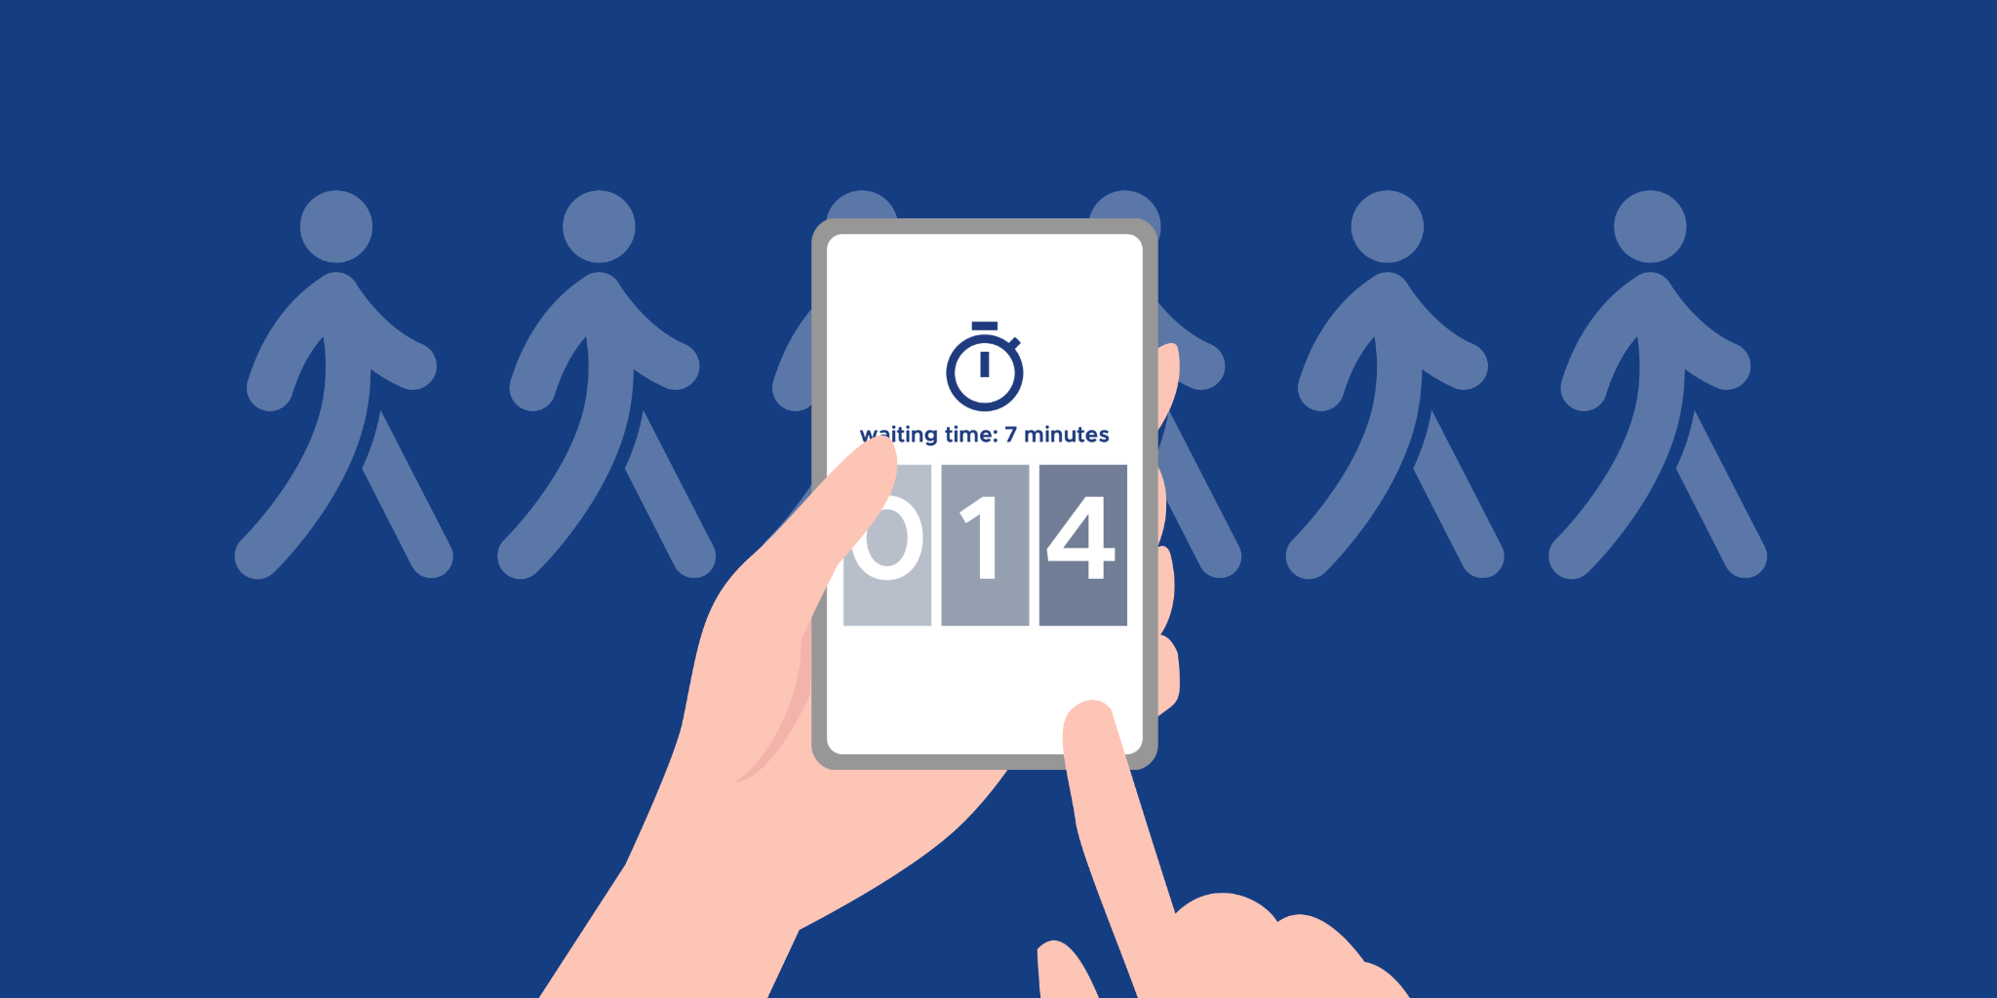
Main feature of the business need
Online queuing feature

Slide 10
02.
Personalized Nutrition and Dietary Accommodation

Slide 11
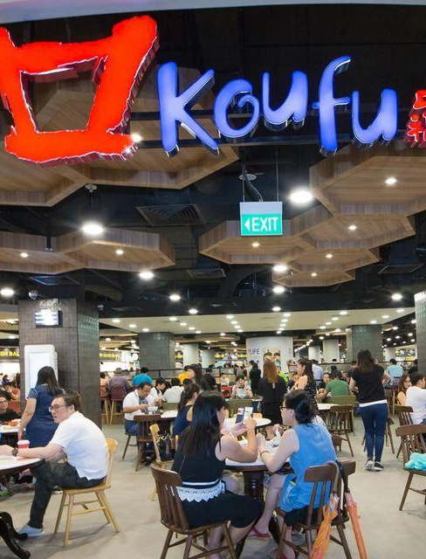
Enhancing the Beverages Experience for Our Valued Elderly Customers
Personalized Nutrition and Digital Innovation at Koufu's Beverage Stall
A customer-centric F&B provider
The need for personalized nutrition to cater to the unique dietary requirements
Opportunity for digital innovation to streamline the process.

Slide 12
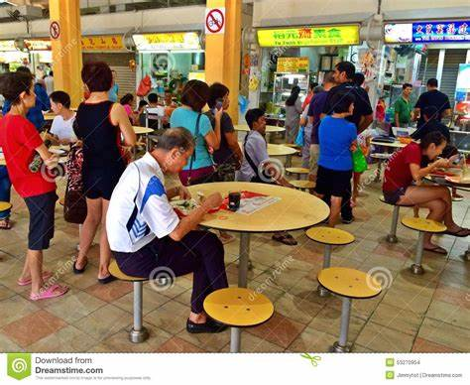
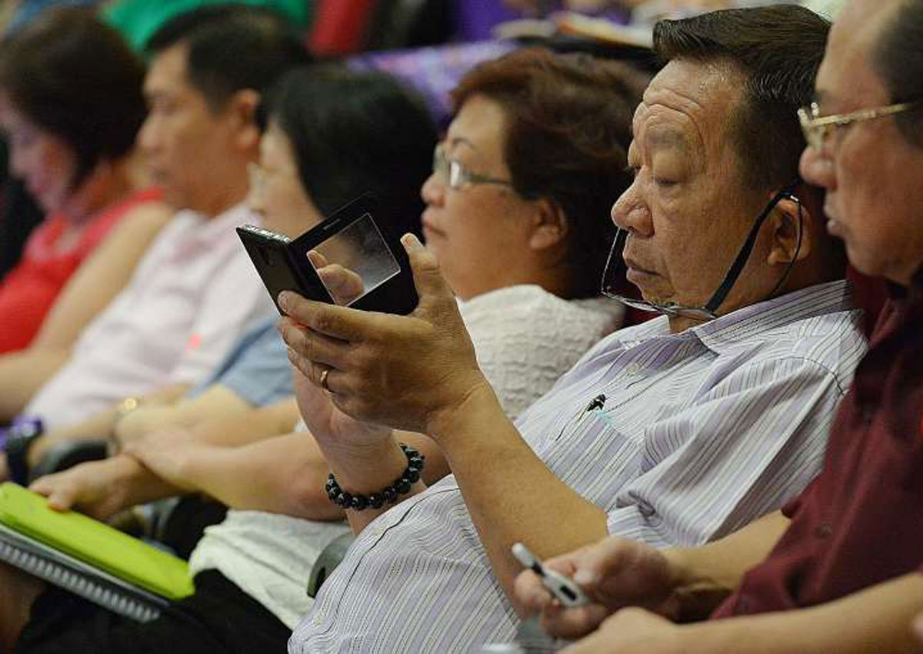
Understanding the Challenge
Challenges faced by the elderly
Navigating long queues
Particular nutritional needs and preferences
Using technology
Key facts:
Senior citizens may need more time and support
Standing in long lines can be physically and mentally exhausting.
Providing a personalized touch and addressing these difficulties require digital innovation.

Slide 13
Introducing “Elderly-Friendly Drink Assistance’’
A Tailored Digital Solution
Personalized Nutrition
Simplified Ordering Process
Nutritional Highlights
Dietary Preferences Profiles for each user
App retains choices for subsequent orders
User-friendly interface with larger text and clear visuals
Navigation made simpler with easily accessible buttons for effortless use.
Each beverage option's nutritional information is presented clearly
Alerts for healthier choices.

Slide 14
03.
Streamlining Checkout Process

Slide 15
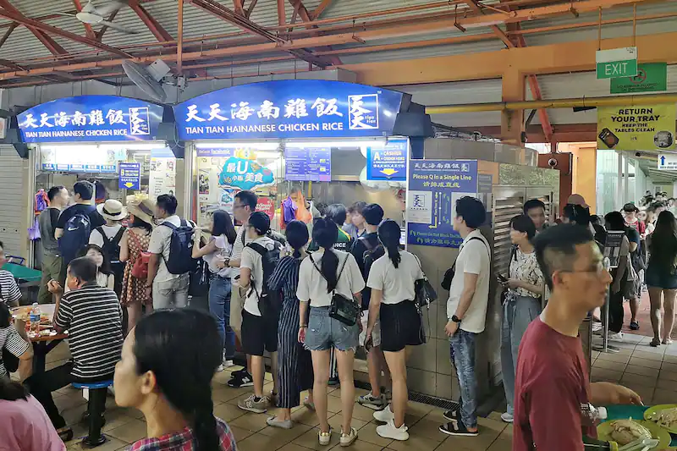


What does this mean?
Introducing more options rather than just having the traditional checkout processes. Limited payment options can cause slower customer flow which may subsequently result in :
Longer queue times
Unhappy customers
Decreased profits

Slide 16



How to achieve this?
Implement digital wallet
Similar to existing ones like GrabPay and ShopeePay
Get points from purchases which can be accumulated to redeem free drinks

Slide 17
How does this help?
↑ Customer Satisfaction
↑ Efficiency
Builds loyalty since there is a reward system
Increased profits from returning customers
Shorter queues and queueing times
More flexible options so checking out takes a shorter amount of time
Elderly have more options since they may not have online payment methods currently

Slide 18

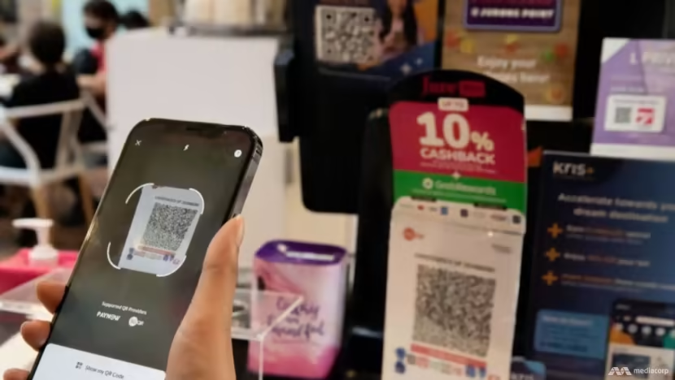


With digital innovations…

Slide 19
04.
Use of digital menu

Slide 20


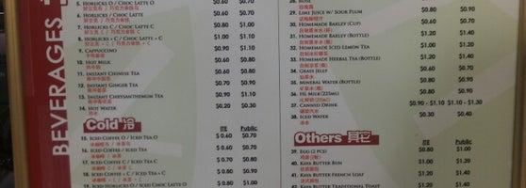
Elderly cannot see clearly
Have to spend more time looking at the printed menu
May find the ordering process stressful and inconvenient

Slide 21
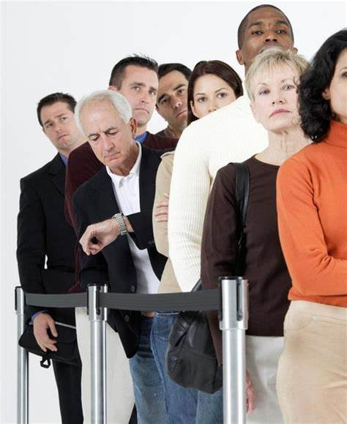

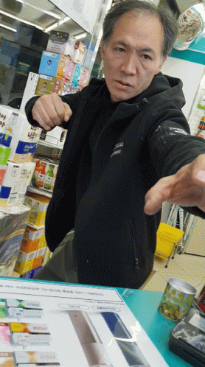

Customers feeling angry, impatient or frustrated
longer waiting time

Slide 22
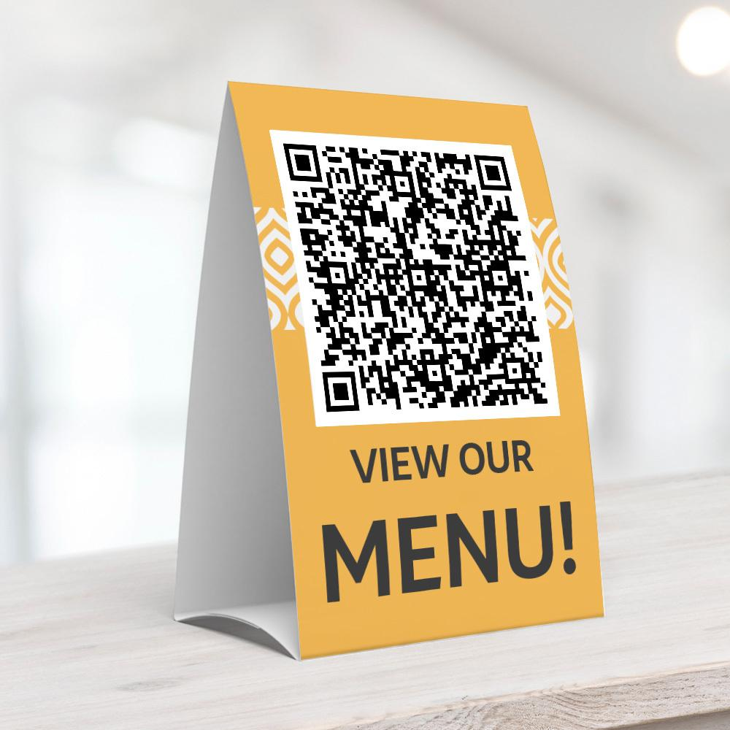
What is the solution?
Digital innovation such as the implementation of a digital menu that can be accessible through scanning a QR code can be a solution to the problem.
What can be found in the digital menu and how can it help?
Visual representations of the menu items
> to make it convenient for elderly who tend to purchase their drinks based on its appearance
Use of large fonts on the price of the drink and detailed information about its ingredients (such as allergen details)
> to help enhance readability for elderly with poor eyesight

Slide 23


Why should we adopt this solution?
This digital innovation can reduce the reliance on printed menu
Contributes to environmental sustainability
Will appeal to environmentally-conscious customers
Helps streamline operations, enhance efficiency
Latest update of price of the menu items is available on the digital menu
Staffs do not need to convey the changes verbally

Slide 24
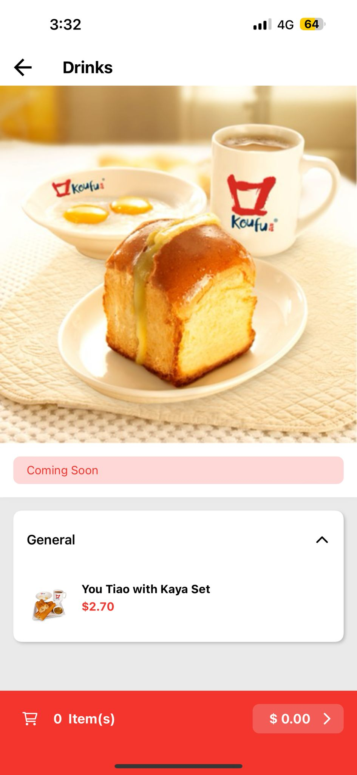
Current App
The current app that they have for Koufu which is supposed to carry out this function, is not fully completed. Some inconsistencies in the app are:
Some outlets have more advanced UI and functionalities
The NYP outlet isn’t functional at all
Only provides English UI
Information given isn’t complete
Can be misleading

Slide 25
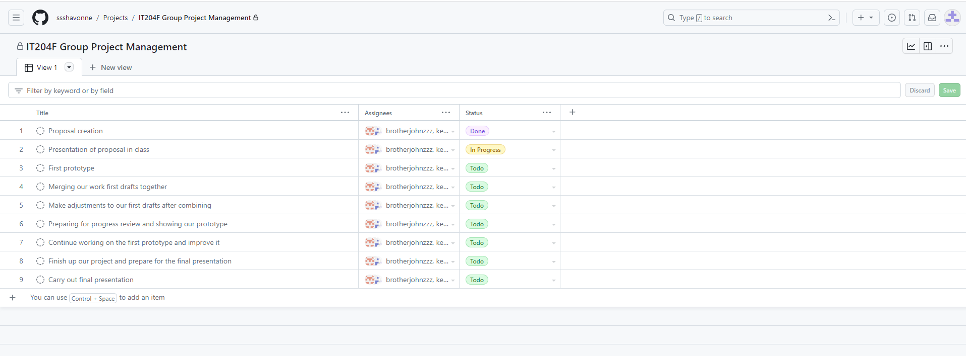
Project Timeline

Slide 26


Thanks!
Do you have any questions?
youremail@freepik.com
+34 654 321 432
yourwebsite.com
Please keep this slide for attribution

